Slide 1
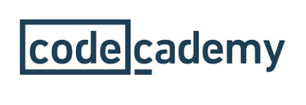
Python Essentials! VIT, Bhopal.
Lets learn Python together ☺

Slide 2


Slide 3


Slide 4
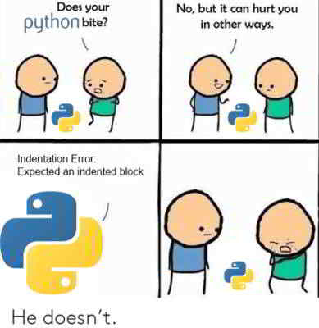

Slide 5
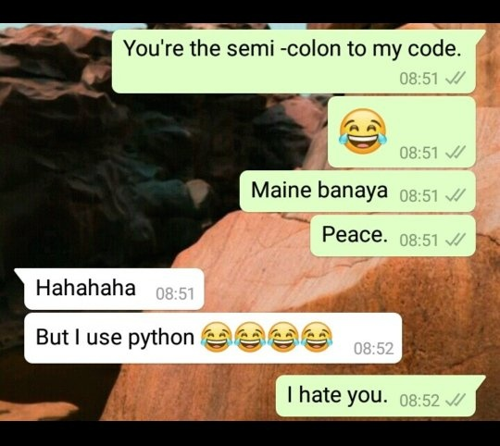

Slide 6
Agenda
Basics: Variables, Data Types, Comments, Built In Functions
Conditionals and Loops in Python
Data Types in Python: Dictionaries, Lists, Sets, Strings, Tuples
Functions in Python

Slide 7

Features of Python
Python is an interpreted, high-level, general- purpose programming language.
Created by Guido van Rossum in 1989.
Python 1.0 released in 1994.
Python 2.0 released in 2000.
Python 3.0 released in 2008.
Guido Van Rousom

Slide 8
Variables
def : Variables are containers for storing data values such as texts and numbers etc.
Unlike other programming languages, Python has no command for declaring a variable.
A variable is created the moment you first assign a value to it.
Variables do not need to be declared with any particular type, and can even change type after they have been set. That's why Python is called as Dynamically Typed Language.

Slide 9
Variables Naming Convention
A variable in Python can have a short name (like x and y) or a more descriptive name (age, myName, total_area).
Rules for Python variables:
A variable name must start with a letter or the underscore character
A variable name cannot start with a number.
A variable name can only contain alpha-numeric characters and underscores (A-z, 0-9, and _ ).
Variable names are case-sensitive (age, Age and AGE are three different variables).
You cannot use a reserved keyword as variable name.

Slide 10
Python Built-in Functions
1. abs()
The abs() is one of the most popular Python built-in functions, which returns the absolute value of a number.
2. all()
The all() function takes a container as an argument. This Built in Functions returns True if all values in a python iterable have a Boolean value of True.
An empty value has a Boolean value of False.
3. bin()
bin() converts an integer to a binary string. We have seen this and other functions in our article on Python Numbers.
4. complex()
complex() function creates a complex number. We have seen this is our article on Python Numbers.
More on Built-In Functions in Python

Slide 11
Conditionals in Python
Booleans are most useful when combined with conditional statements, using the keywords if, elif, and else.
Conditional statements, often referred to as if-then statements, let you control what pieces of code are run based on the value of some Boolean condition.
def inspect(x):
if x == 0:
print(x, "is zero")
elif x > 0:
print(x, "is positive")
elif x < 0:
print(x, "is negative")
else:
print(x, "is unlike anything I've ever seen...")
inspect(0)
inspect(-15)

Slide 12
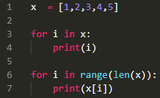

Loops in Python
A for loop is used for iterating over a sequence (that is either a list, a tuple, a dictionary, a set, or a string).
A basic for loop
Ways to Loop over a container

Slide 13
The while Loop
With the while loop we can execute a set of statements as long as a condition is true.
i = 1 while i < 6: print(i) i += 1
The break Statement
With the break statement we can stop the loop even if the while condition is true:
i = 1 while i < 6: print(i) if i == 3: break i += 1
The continue Statement
With the continue statement we can stop the current iteration, and continue with the next

Slide 14
Data Types in Python
Lists
Dictionaries
Strings
Tuples
Sets

Slide 15
Lists
Lists are used to store multiple items in a single variable.
Lists are created using square brackets
List items are ordered, changeable, and allow duplicate values.
List items are indexed, the first item has index [0], the second item has index [1] etc.

Slide 16

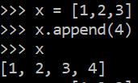
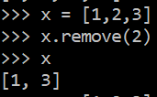
thislist = ["apple", "banana", "cherry"] print(thislist)
When we say that lists are ordered, it means that the items have a defined order, and that order will not change.
If you add new items to a list, the new items will be placed at the end of the list.

Slide 17
The list is changeable, meaning that we can change, add, and remove items in a list after it has been created.
Since lists are indexed, lists can have items with the same value.
len() is used to find the length of the list just like strings.
They can be of any data type. It can also hold elements of different datatypes at the same time.
How can we access list elements?
How can we change list elements?(replace any element)
How can we add list elements?
How can we remove list elements?
How can we loop list elements?
How can we sort list elements?

Slide 18
thislist = ["apple", "banana", "cherry"] thislist[1:2] = ["blackcurrant", "watermelon"] print(thislist)
thislist = ["apple", "banana", "cherry"] thislist.insert(2, "watermelon") print(thislist)
thislist = ["apple", "banana", "cherry"] thislist.append("orange") print(thislist)
thislist = ["apple", "banana", "cherry"] thislist.remove("banana") print(thislist)
thislist = ["apple", "banana", "cherry"] thislist.pop(1) print(thislist)
thislist = ["apple", "banana", "cherry"] del thislist[0] print(thislist)
thislist = ["apple", "banana", "cherry"] for x in thislist: print(x)
thislist = ["orange", "mango", "kiwi", "pineapple", "banana"] thislist.sort() print(thislist)

Slide 19
Dictionaries
Dictionaries are used to store data values in key:value pairs.
A dictionary is a collection which is ordered*, changeable and does not allow duplicates.
thisdict = { "brand": "Ford", "model": "Mustang", "year": 1964 } print(thisdict)
Dictionaries are changeable, meaning that we can change, add or remove items after the dictionary has been created.
Dictionaries cannot have two items with the same key. The values will be overwritten.

Slide 20
How to access a dictionary?
We can access the items of a dictionary by referring to its key name, inside square brackets. The syntax is-
thisdict = { "brand": "Ford", "model": "Mustang", "year": 1964 } x = thisdict["model"]
How to find out all the keys of a dictionary?
The keys() method will return a list of all the keys in the dictionary.
x = thisdict.keys()

Slide 21
How to change the values in a dictionary?(We can also use the update function for this)
thisdict = { "brand": "Ford", "model": "Mustang", "year": 1964 } thisdict["year"] = 2018
How to add items to a dictionary?
Adding an item to the dictionary is done by using a new index key and assigning a value to it:
thisdict["color"] = "red"
How to delete items?- We can use the pop or delete function just like lists.
How to copy a dictionary?
thisdict = { "brand": "Ford", "model": "Mustang", "year": 1964 } mydict = thisdict.copy() print(mydict)

Slide 22
Functions in Python: Lets start with the main function!
Python main function is a starting point of any program. When the program is run, the python interpreter runs the code sequentially. Main function is executed only when it is run as a Python program. It will not run the main function if it imported as a module.
It is important that after defining the main function, you call the code by if__name__== "__main__" and then run the code, only then you will get the output.
Def keyword
The def keyword is used to create, (or define) a function.
def main():
print("Hello from a function")
If __name__==“__main__”:
main()

Slide 23
In Python, a function is a group of related statements that performs a specific task.
Functions help break our program into smaller and modular chunks. As our program grows larger and larger, functions make it more organized and manageable.
Furthermore, it avoids repetition and makes the code reusable.
A function is a block of code which only runs when it is called.
You can pass data, known as parameters, into a function.
A function can return data as a result.
# Python program to execute
# function directly
def my_function():
print ("I am inside function")
# We can test function by calling it.
my_function()

Slide 24
The pass Statement
Function definitions cannot be empty, but if you for some reason have a function definition with no content, put in the pass statement to avoid getting an error.
The return statement
The return statement is used to exit a function and go back to the place from where it was called.
def absolute_value(num):
"""This function returns the absolute
value of the entered number"""
if num >= 0:
return num
else:
return -num
print(absolute_value(2))

Slide 25
List Comprehension
List comprehension offers a shorter syntax when you want to create a new list based on the values of an existing list.
Example:
Based on a list of fruits, you want a new list, containing only the fruits with the letter "a" in the name.
Without list comprehension you will have to write a for statement with a conditional test inside:

Slide 26
fruits = ["apple", "banana", "cherry", "kiwi", "mango"] newlist = [] for x in fruits: if "a" in x: newlist.append(x) print(newlist)
With list comprehension you can do all that with only one line of code:
fruits = ["apple", "banana", "cherry", "kiwi", "mango"] newlist = [x for x in fruits if "a" in x] print(newlist)

Slide 27
Food for Thought!
Look up more about Python Lamda Functions, Python Iterators, Recursion, List Comprehension and Dictionary Comprehension.
Thank you for attending the session!
Time for Q/A :D

